Slide 1
Laboratory Projects for Non-Engineers and Freshman Engineering Students
Kate Disney – Mission College
John Krupczak – Hope College

Slide 2
What is the project about
Engineering GE
Lab based
Investigating the sharing or providing of equipment to see if doing so has an impact on # of labs offered in freshman engineering classes.
The need for engineering GE courses w/ labs
Why is Tech Lit important
Students want to know
Material is very relevant
Project Goals – to put equipment in the hands of faculty (getting equipment and labs is the biggest barrier)
make lab adoption easier
To create easy to replicate labs that represent core tech – not just verifying a scientific principle
Little abstraction – common ordinary parts
To lower costs
To assess the feasibility of sharing equipment by shipping materials and supplies to colleagues
To increase collaboration in the area of freshman lab projects
The importance of the lab component
Added-value
Enhances learning
Ownership
Device satisfies a human need or want
Competitive Edge – hard to replicate
What have we done
Labs
Relationships
Cabrillo Bridge project in exchange for two labs
What have we learned
Why is this a good idea
Benefits to Students
Benefits to Faculty
Barriers to change depend on faculty – but providing lab materials addresses a substantial prep effort, freeing the faculty up to prepare for how material is presented
Next Steps
Canonical Set of labs
More standardization to validate engineering GE
Greater collaboration – repositories of labs – refinement
Commercial Involvement, Economy of Scale, Critical Mass, Course Maturation

Slide 3
Engineering as General Education
“How Everyday Technology Works”
Mission College, Santa Clara, CA
“Science and Technology of Everyday Life”
Hope College, Holland, MI

Slide 4
Survey courses with a lab component
Focus on familiar Core Technology
Promoted to all college students
Natural Language based

Slide 5
The Project:
Investigate the feasibility for sharing lab equipment
Assess the benefits of providing faculty with lab materials by tracking the number of new labs adopted into freshman engineering courses.

Slide 6
Why offer Technological Literacy courses to non-science majors?
Material is relevant. All of us use and depend on technology.
More decisions require an understanding of technology
The workings of technology are often hidden behind a user interface or exist at a microscopic level, and interaction does not require any understanding of the technology.
The use and the understanding of common technology increases our capabilities and effectiveness.
A bridge to technology and engineering for the non-science major

Slide 7
Importance of a lab component
Direct, personal, experience through lab projects.
Dissection Activities
“Make and Take” lab projects
All hands-on
Projects are kept simple so that students can complete a lab in one period.
Simple parts to reduce any abstractions
Added-Value to course
Distinguishes the course from other science courses.
Providing students with a course that will not be easily found elsewhere. No online course equivalent.

Slide 8
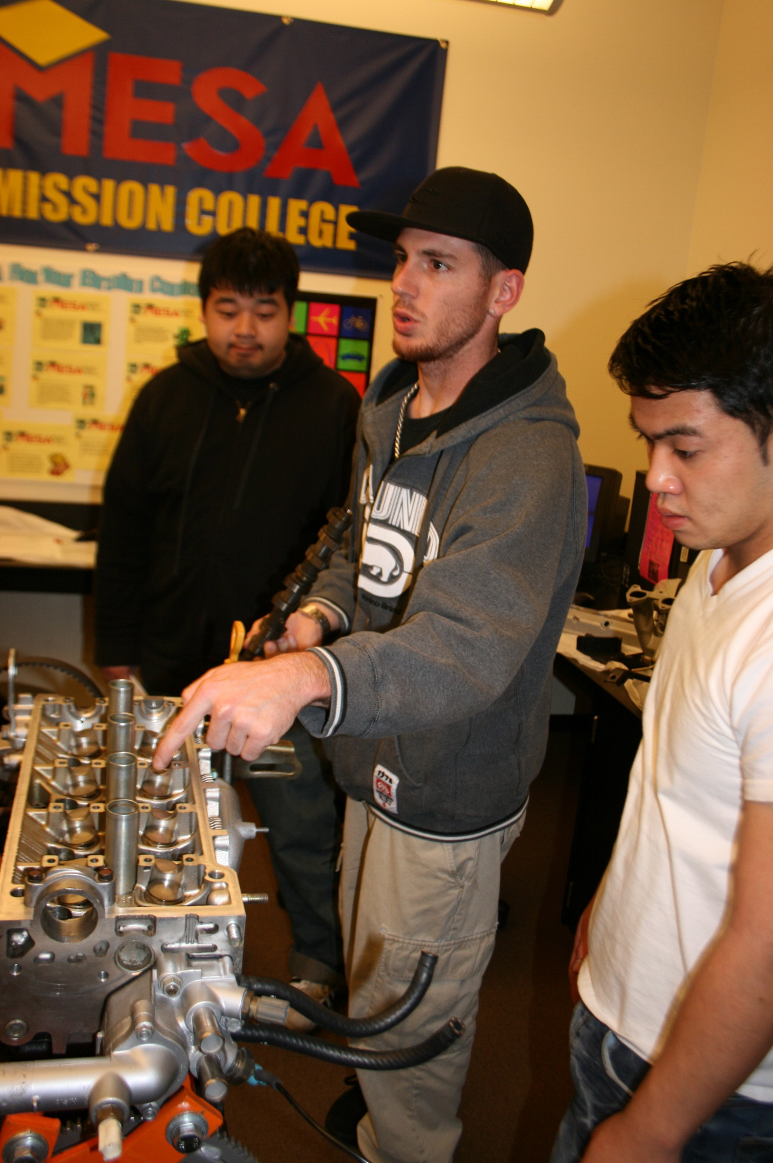
Barriers to offering labs
Cost
Some Colleges have annual budgets of less than $1000
Lab Development Time
On-going lab prep
Space
Faculty Comfort Areas
Small Depts.
4-Cylinder Engine Lab

Slide 9
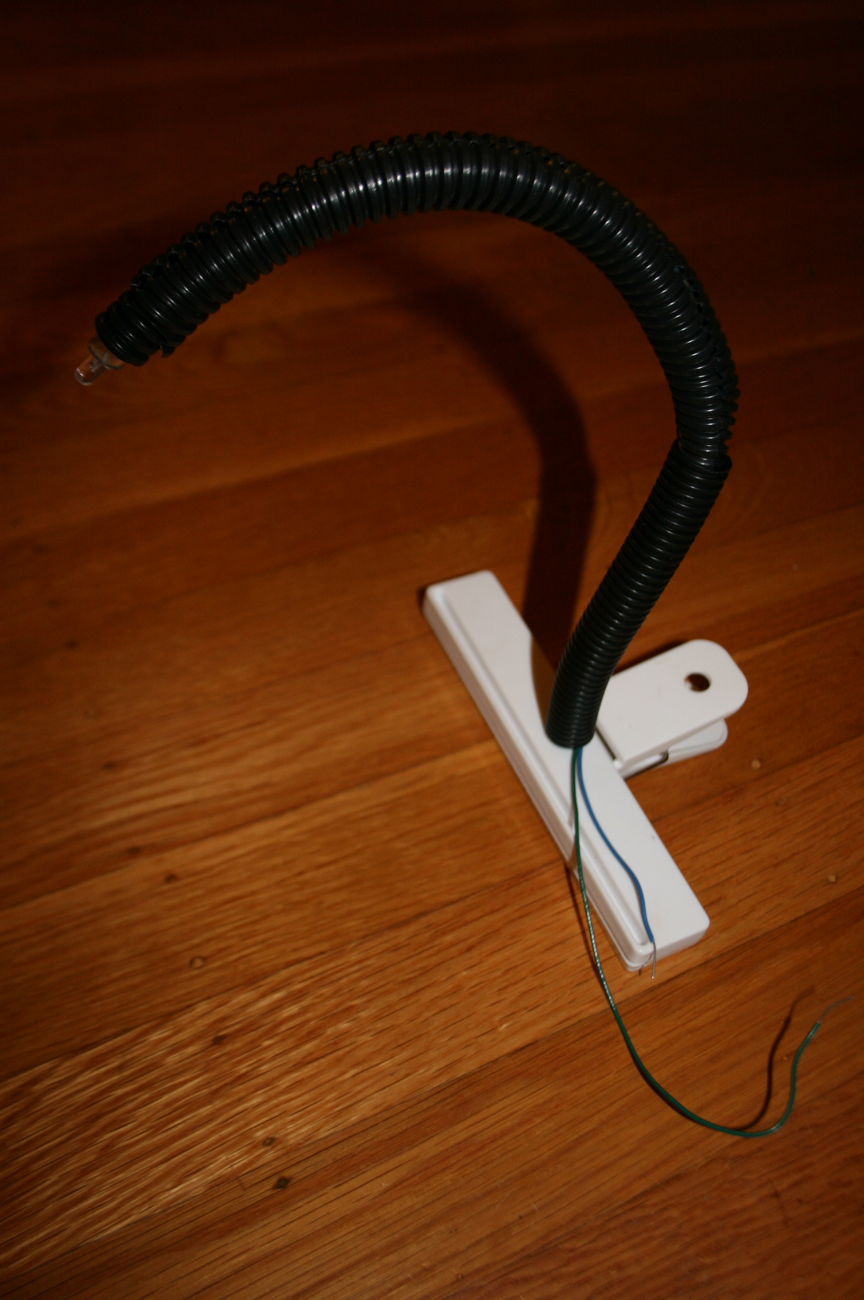
Project Plan
Share lab equipment
Provide student kits temporarily until lab is adopted
Use existing shipping infrastructure
Develop easy to replicate labs that represent core technology
Clip-on Automatic Light

Slide 10
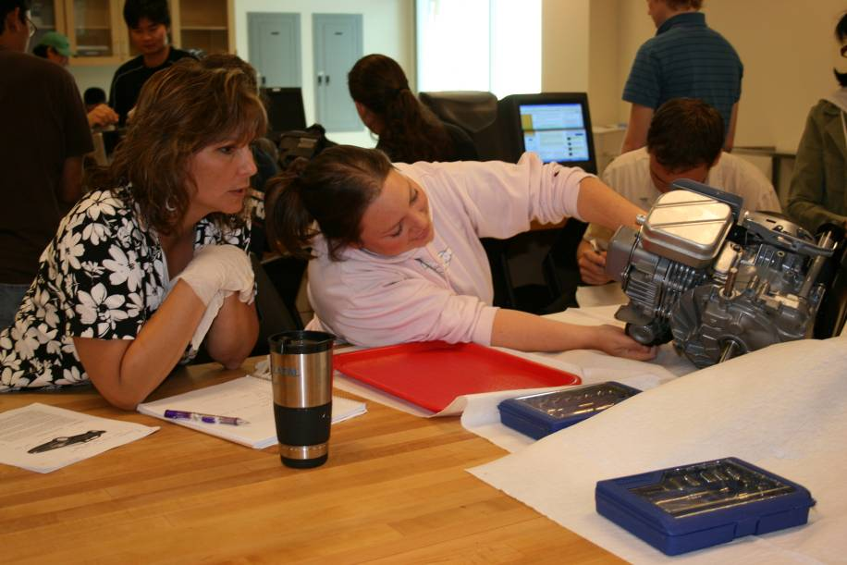
Labs
Toy Car with Flywheel
Mechanical Alarm Clock
Four Cylinder Car Engine
Clip-on Light using LED
Speaker
DC Motor
AM Radio

Slide 11
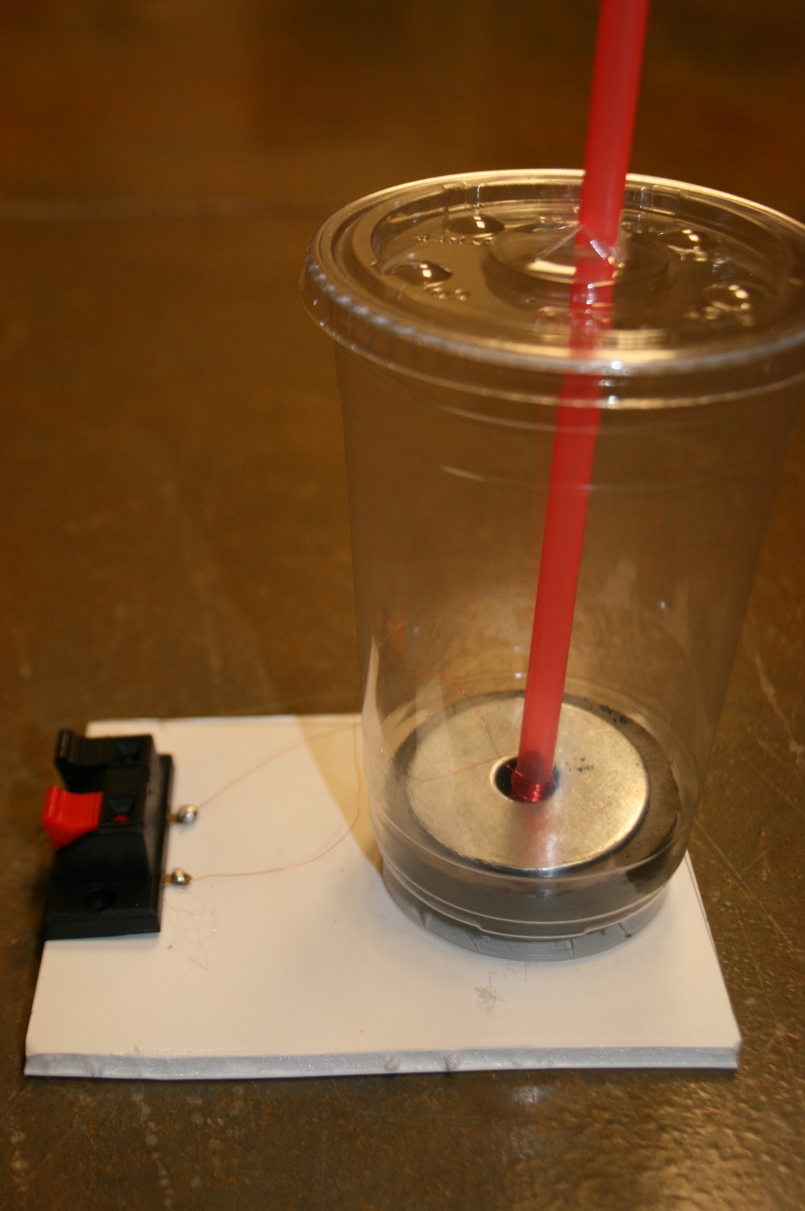
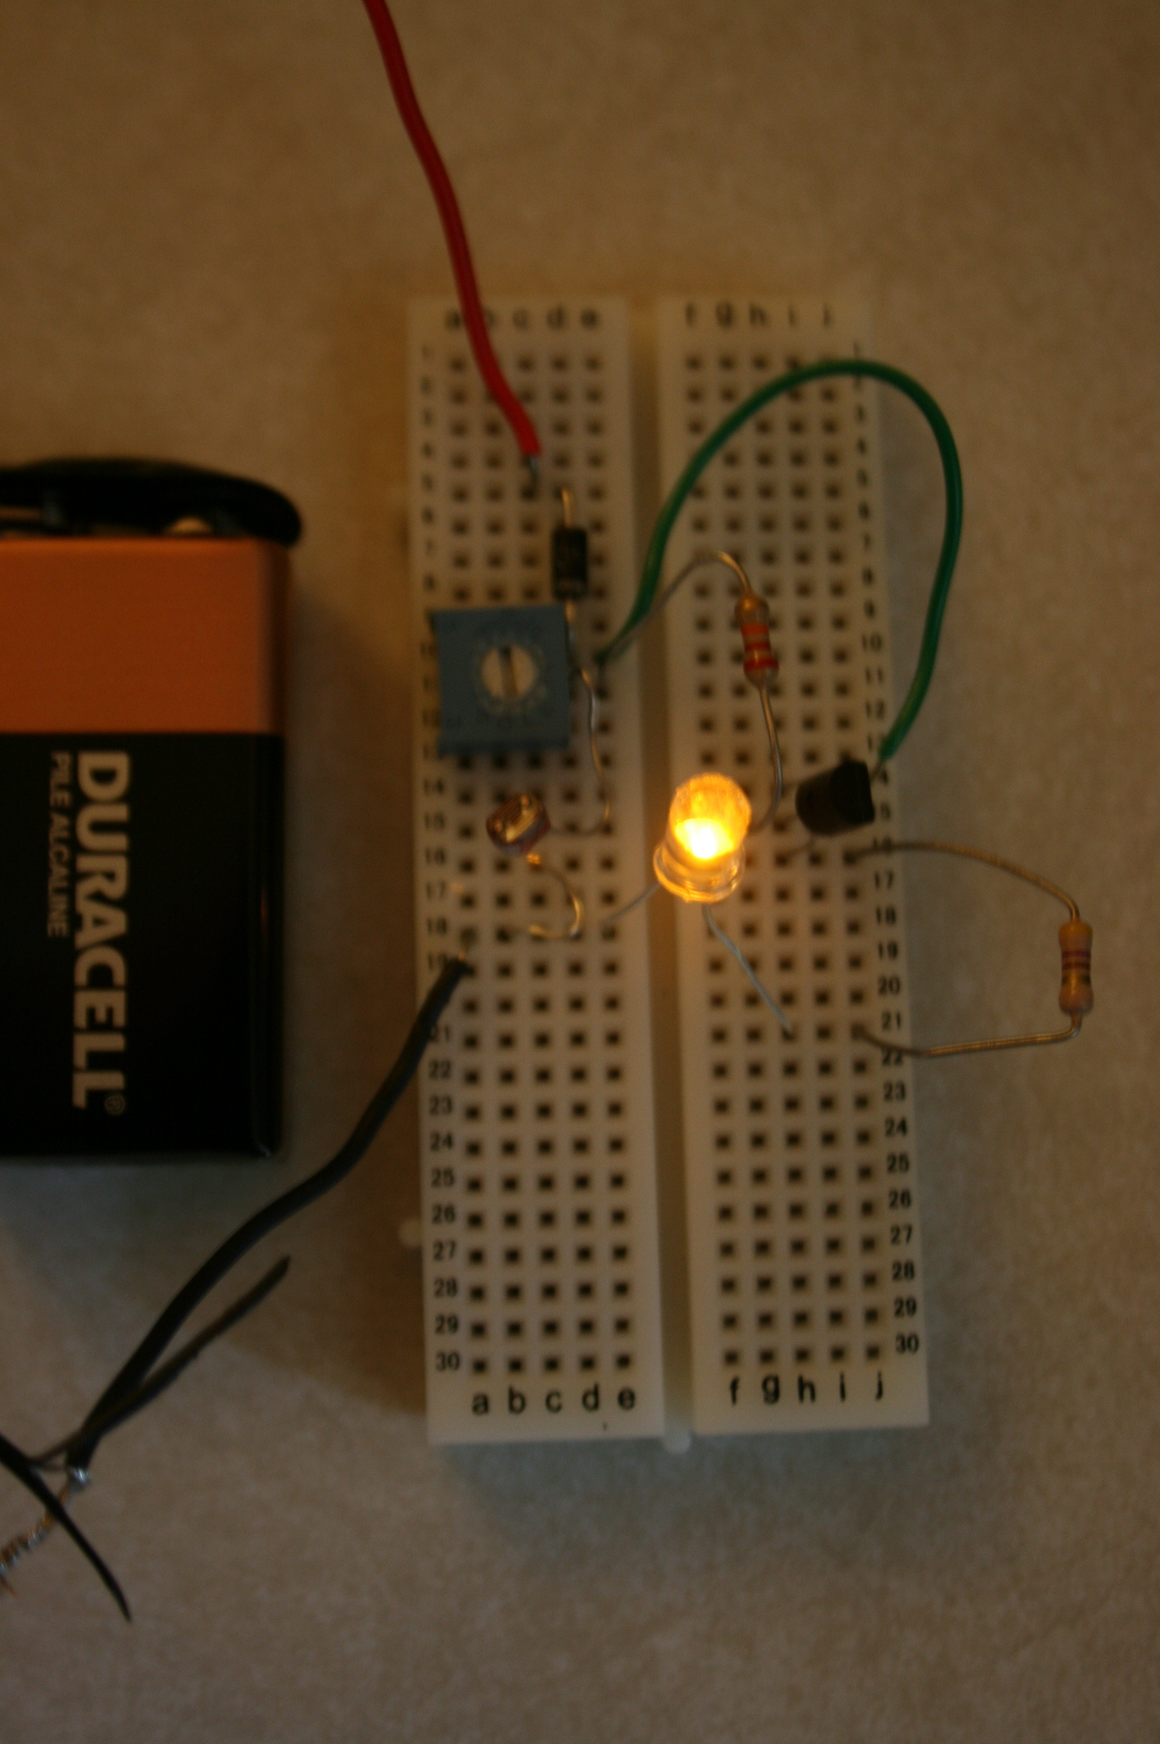
Audio Amplifier
Battery recharger using PV solar cells
Night Light using Light-Dependent-Resistor and
transistor.
Speaker
Night Light

Slide 12
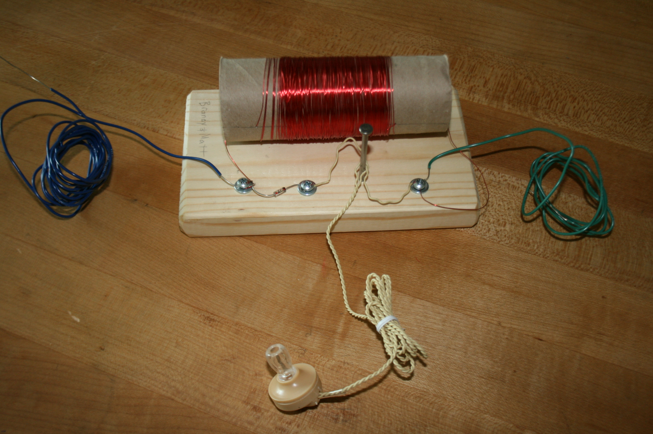
AM Radio

Slide 13
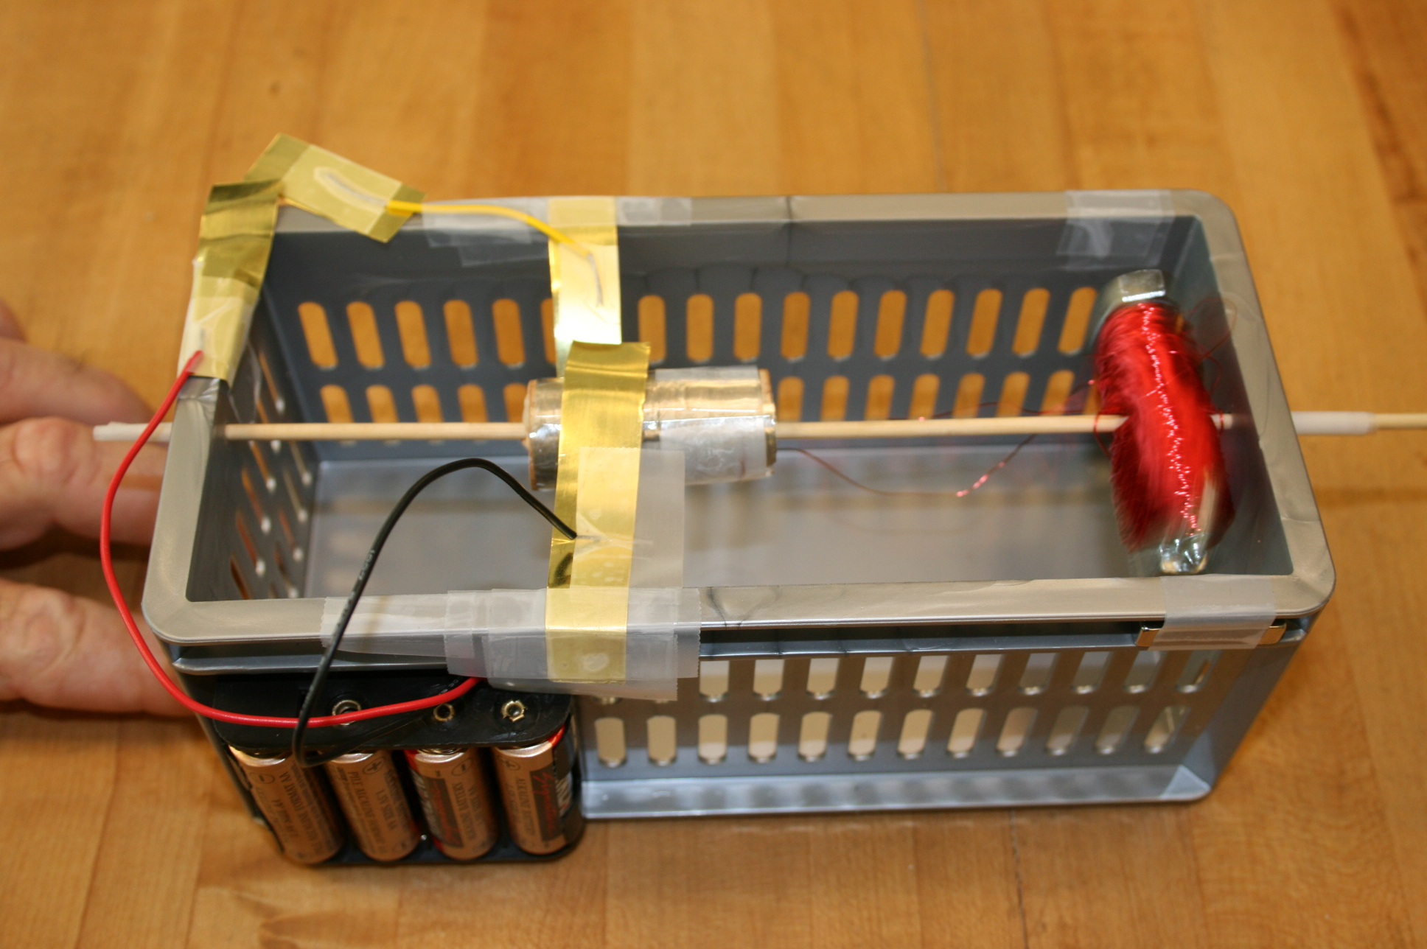
DC Motor

Slide 14
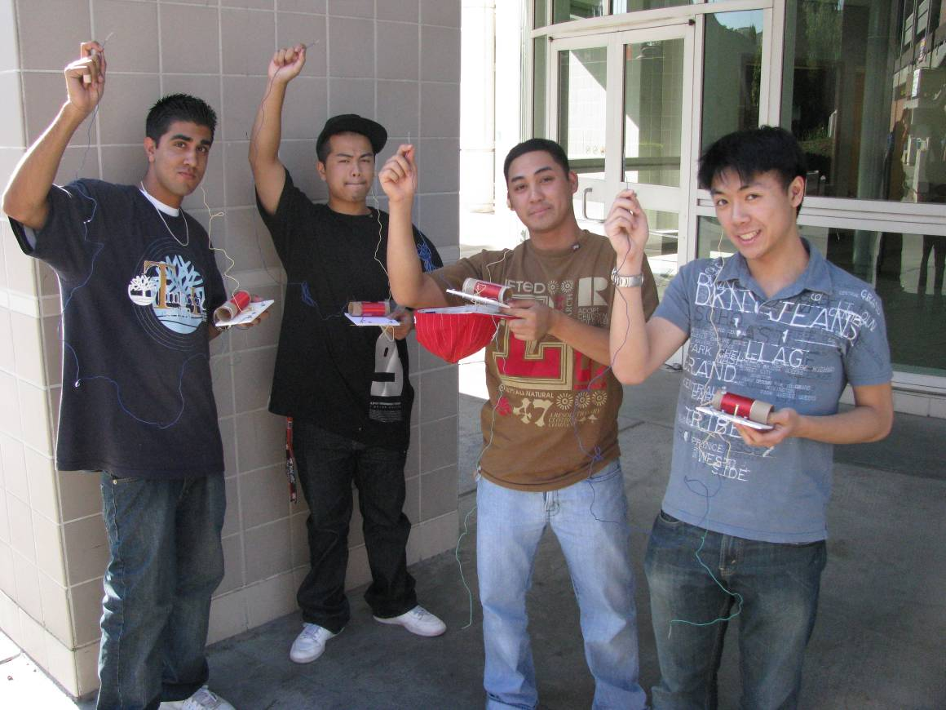
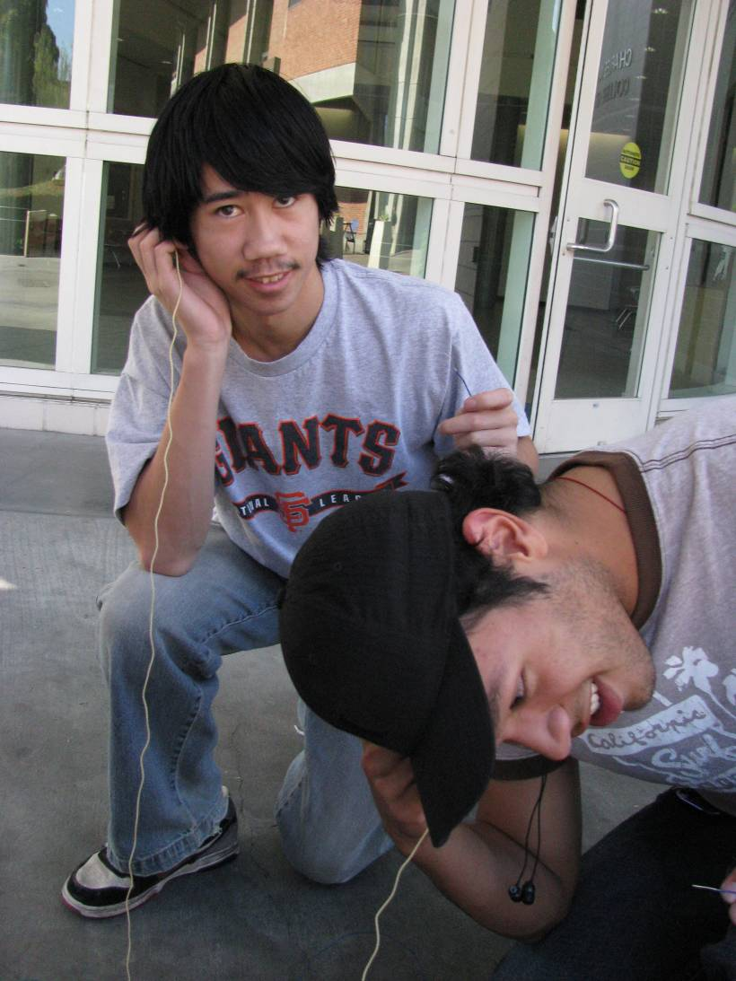
Radio Lab

Slide 15
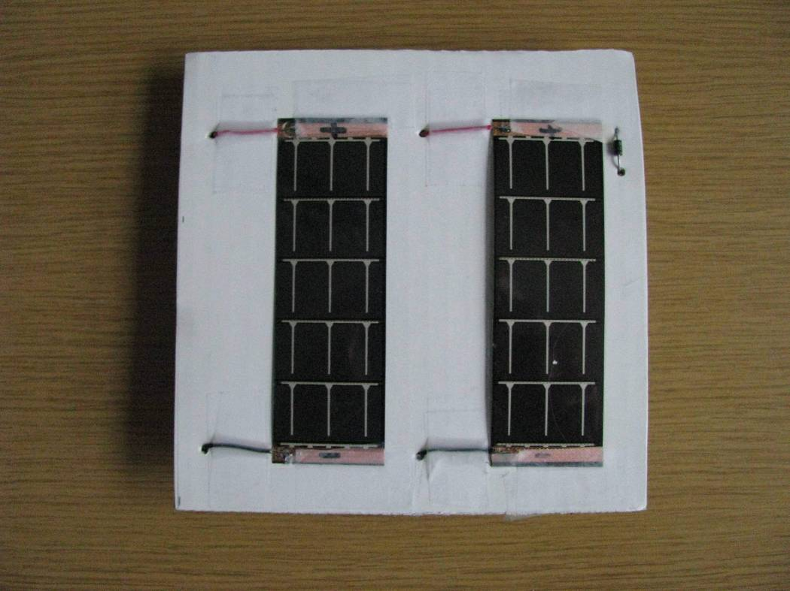
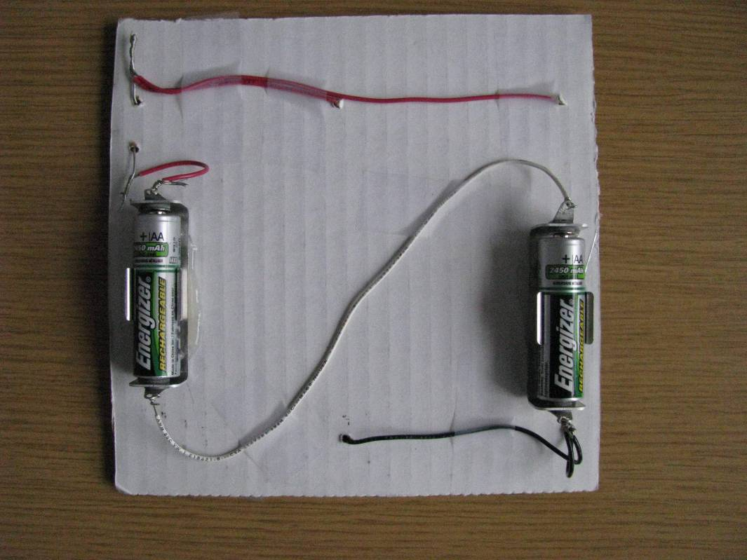
Solar Cell Battery Recharger

Slide 16
Lab Requirements
Parts should be the bare essentials needed to make the object function.
Use common, ordinary parts to eliminate any abstraction.
Focus on core technology. Build devices that students have experience with as users.
Devices should satisfy a human need or want.
If doing dissection, choose devices that have sub-parts, allowing for functional decomposition.

Slide 17
Lab Test Sites
Ohlone College
Computers, Networks, & Emerging Technologies
Las Positas College
Introduction to Engineering
San Jose State University
Introduction to Engineering
Cabrillo College
Introduction to Engineering
Ventura College
Introduction to Engineering

Slide 18
Benefits to Faculty
Initial lab development is not required
Lab has been used elsewhere
Collaborative lab refinement process
Obtaining labs outside one’s area of expertise

Slide 19
Next Steps
More contributors
A large set of labs that converge into a canonical set of “classic” engineering labs.
Validate engineering as general education
Provide a baseline for faculty to work from
Simplify articulation agreements
Continue with efforts to get labs adopted
Obtain a scale so that lab materials can be made affordable from commercial vendors.

Slide 20
NSF Support
DUE #0633277

Slide 21
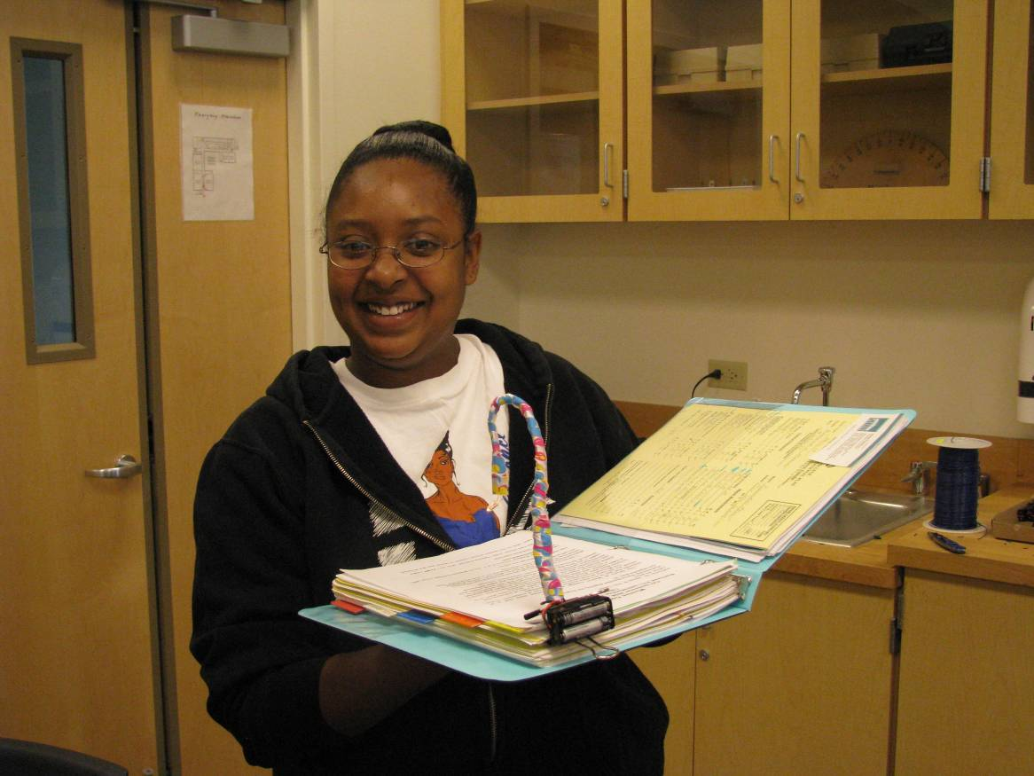
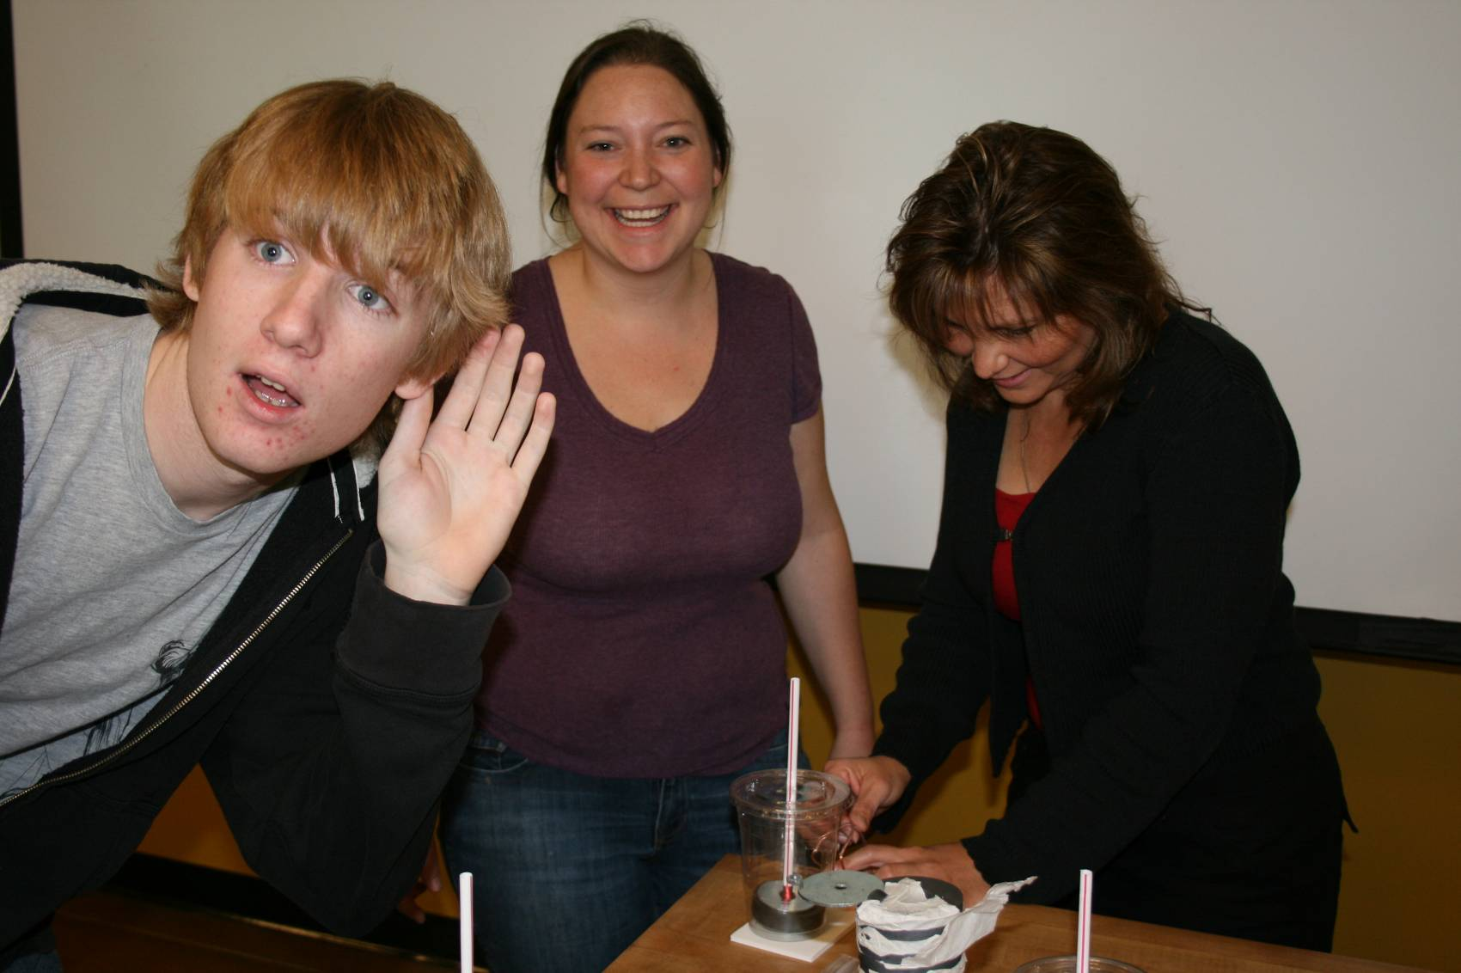
It Works!

